Slide 1
Announcement
We will have a 10 minutes Quiz on Feb. 4 at the end of the lecture. The quiz is about Big O notation.
The weight of this quiz is 3% (please refer to week1' slides).
Analysis of Algorithms

Slide 2
Analysis of Algorithms
Estimate the running time
Estimate the memory space required.
Time and space depend on the input size.
Analysis of Algorithms

Slide 3
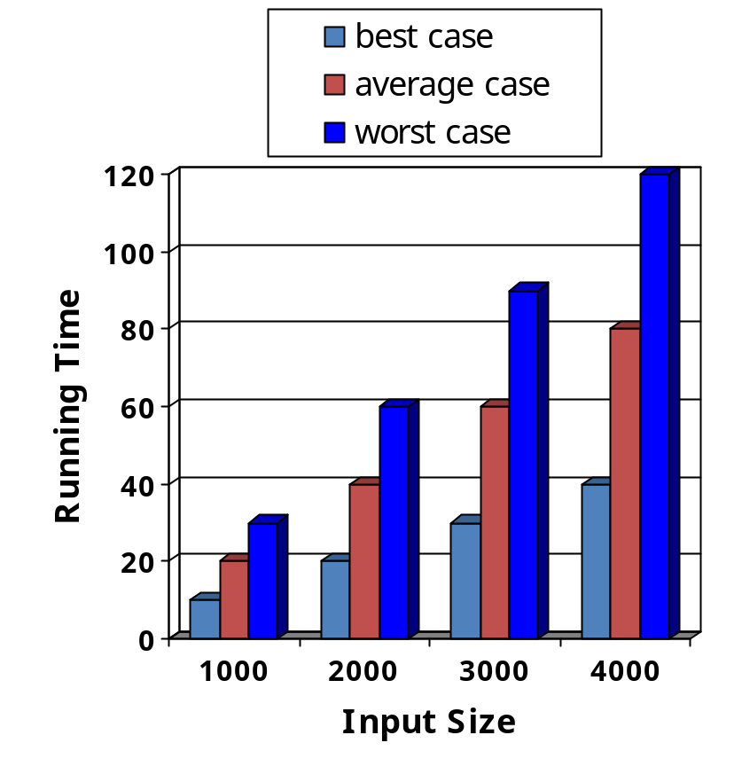
Running Time (§3.1)
Most algorithms transform input objects into output objects.
The running time of an algorithm typically grows with the input size.
Average case time is often difficult to determine.
We focus on the worst case running time.
  Easier to analyze
  Crucial to applications such as games, finance and robotics
Analysis of Algorithms

Slide 4
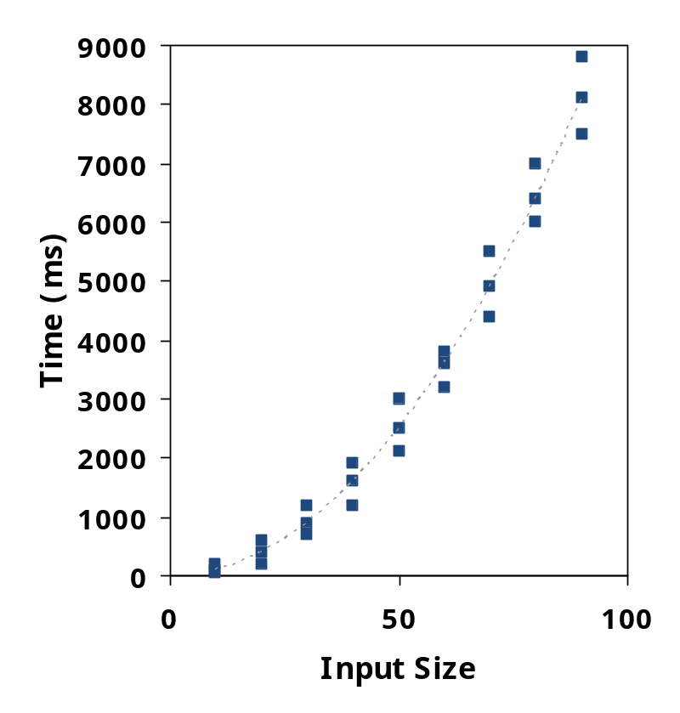
Experimental Studies
Write a program implementing the algorithm
Run the program with inputs of varying size and composition
Use a method like System.currentTimeMillis() to get an accurate measure of the actual running time
Plot the results
Analysis of Algorithms

Slide 5

Limitations of Experiments
It is necessary to implement the algorithm, which may be difficult
Results may not be indicative of the running time on other inputs not included in the experiment.
In order to compare two algorithms, the same hardware and software environments must be used
Analysis of Algorithms

Slide 6

Theoretical Analysis
Uses a high-level description of the algorithm instead of an implementation
Characterizes running time as a function of the input size, n.
Takes into account all possible inputs
Allows us to evaluate the speed of an algorithm independent of the hardware/software environment
Analysis of Algorithms

Slide 7
Pseudocode (§3.2)
Example: find max element of an array
High-level description of an algorithm
More structured than English prose
Less detailed than a program
Preferred notation for describing algorithms
Hides program design issues
Algorithm arrayMax(A, n)
Input array A of n integers
Output maximum element of A
currentMax ← A[0]
for i ← 1 to n − 1 do
if A[i] > currentMax then
currentMax ← A[i]
return currentMax
Analysis of Algorithms

Slide 8
Pseudocode Details
Control flow
  if … then … [else …]
  while … do …
  repeat … until …
  for … do …
  Indentation replaces braces
Method declaration
  Algorithm method (arg [, arg…])
  Input …
  Output …
Expressions
  Assignment
  (like = in Java)
  Equality testing
  (like == in Java)
  n² Superscripts and other mathematical formatting allowed
Analysis of Algorithms

Slide 9

Primitive Operations (time unit)
Basic computations performed by an algorithm
Identifiable in pseudocode
Largely independent from the programming language
Exact definition not important (we will see why later)
Assumed to take a constant amount of time in the RAM model
Assembly language: contains a set of instructions. http://www.tutorialspoint.com/assembly_programming/index.htm
Examples:
  Evaluating an expression
  Assigning a value to a variable
  Indexing into an array
  Calling a method
  Returning from a method
  Comparison x==y
  x>Y
Analysis of Algorithms

Slide 10
Counting Primitive Operations (§3.4)
By inspecting the pseudocode, we can determine the maximum number of primitive operations executed by an algorithm, as a function of the input size
Algorithm arrayMax(A, n)
# operations
currentMax ← A[0] 2
for (i =1; i<n; i++) 2n
(i=1 once, i<n n times, i++ (n-1) times)
if A[i] > currentMax then 2(n − 1)
currentMax ← A[i] 2(n − 1)
return currentMax 1
Total 6n −1
Analysis of Algorithms

Slide 11

Estimating Running Time
Algorithm arrayMax executes 6n − 1 primitive operations in the worst case.
Define:
  a = Time taken by the fastest primitive operation
  b = Time taken by the slowest primitive operation
Let T(n) be worst-case time of arrayMax. Then
a (6n − 2) ≤ T(n) ≤ b(6n − 2)
Hence, the running time T(n) is bounded by two linear functions
Analysis of Algorithms

Slide 12

Growth Rate of Running Time
Changing the hardware/ software environment
  Affects T(n) by a constant factor, but
  Does not alter the growth rate of T(n)
The linear growth rate of the running time T(n) is an intrinsic property of algorithm arrayMax
Analysis of Algorithms

Slide 13
n | logn | n | nlogn | n² | n³ | 2^{n}
4 | 2 | 4 | 8 | 16 | 64 | 16
8 | 3 | 8 | 24 | 64 | 512 | 256
16 | 4 | 16 | 64 | 256 | 4,096 | 65,536
32 | 5 | 32 | 160 | 1,024 | 32,768 | 4,294,967,296
64 | 6 | 64 | 384 | 4,094 | 262,144 | 1.84 * 10¹⁹
128 | 7 | 128 | 896 | 16,384 | 2,097,152 | 3.40 * 10³⁸
256 | 8 | 256 | 2,048 | 65,536 | 16,777,216 | 1.15 * 10⁷⁷
512 | 9 | 512 | 4,608 | 262,144 | 134,217,728 | 1.34 * 10¹⁵⁴
1024 | 10 | 1,024 | 10,240 | 1,048,576 | 1,073,741,824 | 1.79 * 10³⁰⁸
The Growth Rate of the Six Popular functions
Analysis of Algorithms

Slide 14
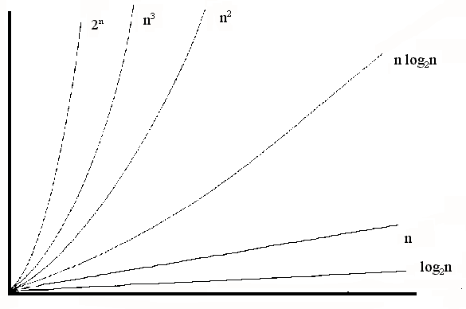
Common growth rates

Slide 15
Big-Oh Notation
To simplify the running time estimation,
for a function f(n), we drop the leading constants and delete lower order terms.
Example: 10n³+4n²-4n+5 is O(n³).
Analysis of Algorithms

Slide 16
Big-Oh Defined
The O symbol was introduced in 1927 to indicate relative growth of two functions based on asymptotic behavior of the functions now used to classify functions and families of functions
f(n) = O(g(n)) if there are constants c and n0 such that f(n) < c*g(n) when n ≥ n₀
c*g(n) is an upper bound for f(n)
c*g(n)
f(n)
n₀
n

Slide 17
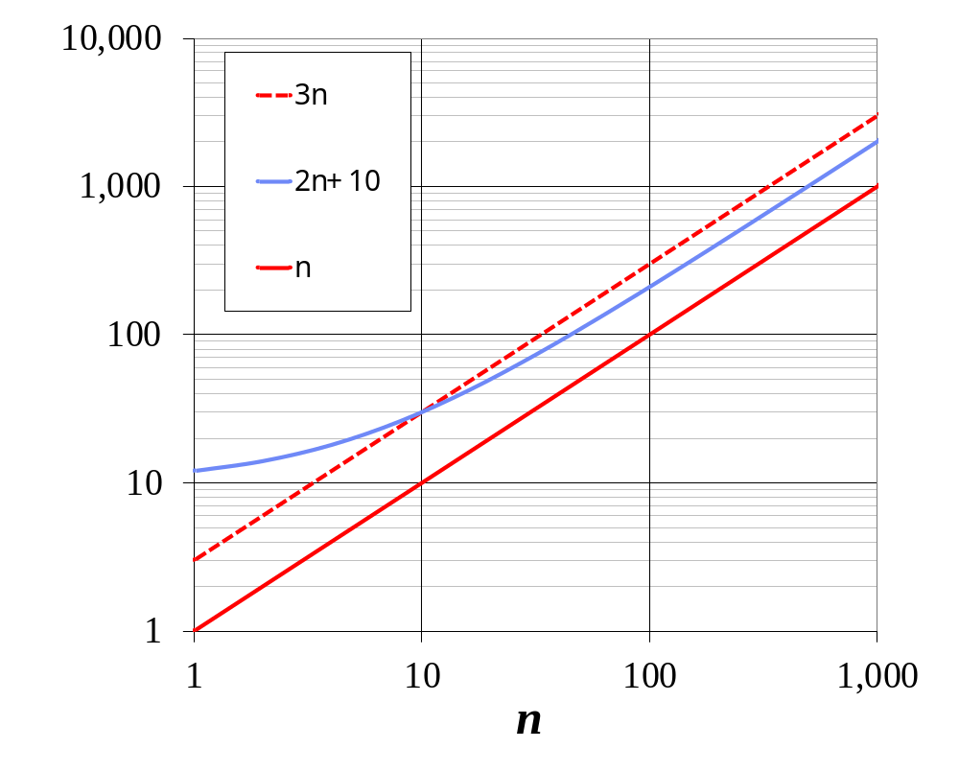
Big-Oh Example
Example: 2n + 10 is O(n)
  2n + 10 ≤ cn
  (c − 2) n ≥ 10
  n ≥ 10/(c − 2)
  Pick c = 3 and n₀ = 10
Analysis of Algorithms

Slide 18
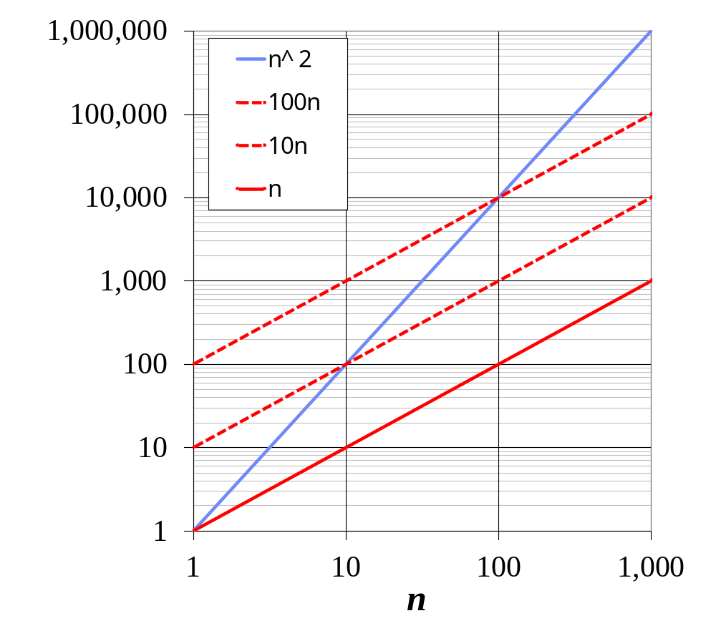
Big-Oh Example
Example: the function n² is not O(n)
  n² ≤ cn
  n ≤ c
  The above inequality cannot be satisfied since c must be a constant
  n² is O(n²).
Analysis of Algorithms

Slide 19


More Big-Oh Examples
7n-2
  7n-2 is O(n)
  need c > 0 and n₀ ≥ 1 such that 7n-2 ≤ c•n for n ≥ n₀
  this is true for c = 7 and n₀ = 1
Analysis of Algorithms

Slide 20
More Big-Oh Examples
3n³ + 20n² + 5
  3n³ + 20n² + 5 is O(n³)
  need c > 0 and n₀ ≥ 1 such that 3n³ + 20n² + 5 ≤ c•n³ for n ≥ n₀
  this is true for c = 4 and n₀ = 21
Analysis of Algorithms

Slide 21
More Big-Oh Examples
3 log n + 5
  3 log n + 5 is O(log n)
  need c > 0 and n₀ ≥ 1 such that 3 log n + 5 ≤ c•log n for n ≥ n₀
  this is true for c = 8 and n₀ = 2
Analysis of Algorithms

Slide 22
More Big-Oh Examples
10000n + 5
  10000n is O(n)
  f(n)=10000n and g(n)=n, n₀ = 10000 and c = 1 then f(n) < 1*g(n) where n > n₀ and we say that f(n) = O(g(n))
Analysis of Algorithms

Slide 23
More examples
What about f(n) = 4n² ? Is it O(n)?
  Find a c such that 4n² < cn for any n > n0
  4n<c and thus c is not a constant.
50n³ + 20n + 4 is O(n³)
  Would be correct to say is O(n³+n)
    Not useful, as n³ exceeds by far n, for large values
  Would be correct to say is O(n⁵)
    OK, but g(n) should be as closed as possible to f(n)
3log(n) + log (log (n)) = O( ? )

Slide 24
Big-Oh Examples
Suppose a program P is O(n³), and a program Q is O(3^{n}), and that currently both can solve problems of size 50 in 1 hour. If the programs are run on another system that executes exactly 729 times as fast as the original system, what size problems will they be able to solve?

Slide 25
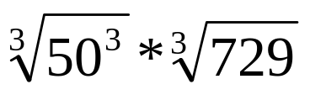
Big-Oh Examples
n³ = 50³ ∗ 729 3^{n} = 3⁵⁰ ∗ 729
n = n = log₃ (729 ∗ 3⁵⁰)
n = log₃(729) + log₃ 3⁵⁰
n = 50 ∗ 9 n = 6 + log₃ 3⁵⁰
n = 50 ∗ 9 = 450 n = 6 + 50 = 56
Improvement: problem size increased by 9 times for n³ algorithm but only a slight improvement in problem size (+6) for exponential algorithm.

Slide 26
Problems
    N² = O(N²) true
    2N = O(N²) true
    N = O(N²) true
    N² = O(N) false
    2N = O(N) true
    N = O(N) true

Slide 27

Big-Oh Rules
If f(n) is a polynomial of degree d, then f(n) is O(n^{d}), i.e.,
  Delete lower-order terms
  Drop leading constant factors
Use the smallest possible class of functions
  Say “2n is O(n)” instead of “2n is O(n²)”
Use the simplest expression of the class
  Say “3n + 5 is O(n)” instead of “3n + 5 is O(3n)”
Analysis of Algorithms

Slide 28
Big-Oh and Growth Rate
The big-Oh notation gives an upper bound on the growth rate of a function
The statement “f(n) is O(g(n))” means that the growth rate of f(n) is no more than the growth rate of g(n)
We can use the big-Oh notation to rank functions according to their growth rate
Analysis of Algorithms

Slide 29
Growth Rate of Running Time
Consider a program with time complexity O(n²).
For the input of size n, it takes 5 seconds.
If the input size is doubled (2n), then it takes 20 seconds.
Consider a program with time complexity O(n).
For the input of size n, it takes 5 seconds.
If the input size is doubled (2n), then it takes 10 seconds.
Consider a program with time complexity O(n³).
For the input of size n, it takes 5 seconds.
If the input size is doubled (2n), then it takes 40 seconds.
Analysis of Algorithms

Slide 30
Asymptotic Algorithm Analysis
The asymptotic analysis of an algorithm determines the running time in big-Oh notation
To perform the asymptotic analysis
  We find the worst-case number of primitive operations executed as a function of the input size
  We express this function with big-Oh notation
Example:
  We determine that algorithm arrayMax executes at most 6n − 1 primitive operations
  We say that algorithm arrayMax “runs in O(n) time”
Since constant factors and lower-order terms are eventually dropped anyhow, we can disregard them when counting primitive operations
Analysis of Algorithms

Slide 31

Computing Prefix Averages
We further illustrate asymptotic analysis with two algorithms for prefix averages
The i-th prefix average of an array X is average of the first (i + 1) elements of X:
A[i] = (X[0] + X[1] + … + X[i])/(i+1)
Computing the array A of prefix averages of another array X has applications to financial analysis
Analysis of Algorithms

Slide 32
Prefix Averages (Quadratic)
The following algorithm computes prefix averages in quadratic time by applying the definition
Algorithm prefixAverages1(X, n)
Input array X of n integers
Output array A of prefix averages of X #operations
A ← new array of n integers O(n)
for i ← 0 to n − 1 do O(n)
{ s ← X[0] O(n)
for j ← 1 to i do O(1 + 2 + …+ (n − 1))
s ← s + X[j] O(1 + 2 + …+ (n − 1))
A[i] ← s / (i + 1) } n
return A 1
Analysis of Algorithms

Slide 33
Arithmetic Progression
The running time of prefixAverages1 is
O(1 + 2 + …+ n)
The sum of the first n integers is n(n + 1) / 2
  There is a simple visual proof of this fact
Thus, algorithm prefixAverages1 runs in O(n²) time
Analysis of Algorithms

Slide 34
Prefix Averages (Linear)
The following algorithm computes prefix averages in linear time by keeping a running sum
Algorithm prefixAverages2(X, n)
Input array X of n integers
Output array A of prefix averages of X #operations
A ← new array of n integers O(n)
s ← 0 O(1)
for i ← 0 to n − 1 do O(n)
{s ← s + X[i] O(n)
A[i] ← s / (i + 1) } O(n)
return A O(1)
Algorithm prefixAverages2 runs in O(n) time
Analysis of Algorithms

Slide 35
Exercise: Give a big-Oh characterization
Algorithm Ex1(A, n)
Input an array X of n integers
Output the sum of the elements in A
s ← A[0]
for i ← 0 to n − 1 do
s ← s + A[i]
return s
Analysis of Algorithms

Slide 36
Common time complexities
BETTER
WORSE
O(1) constant time
O(log n) log time
O(n) linear time
O(n log n) log linear time
O(n²) quadratic time
O(n³) cubic time
O(2^{n}) exponential time

Slide 37
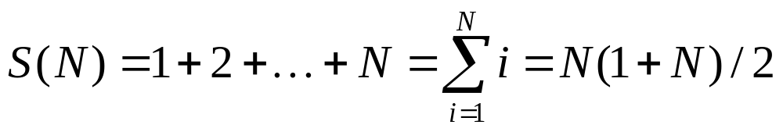
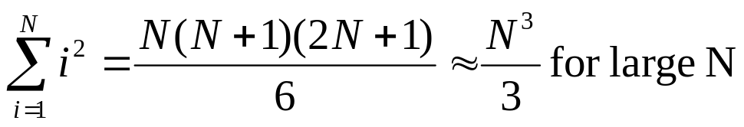
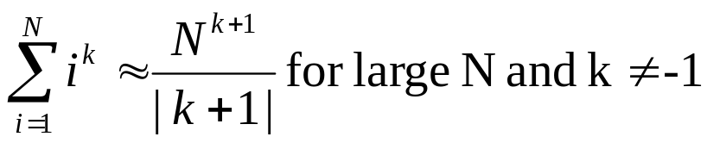
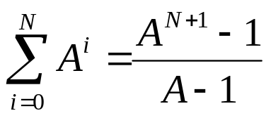
Important Series
Sum of squares:
Sum of exponents:
Geometric series:
  Special case when A = 2
    2⁰ + 2¹ + 2² + … + 2^{N} = 2^{N+1} - 1

Slide 38
Exercise: Give a big-Oh characterization
Algorithm Ex2(A, n)
Input an array X of n integers
Output the sum of the elements at even cells in A
s ← A[0]
for i ← 2 to n − 1 by increments of 2 do
s ← s + A[i]
return s
Analysis of Algorithms

Slide 39
Exercise: Give a big-Oh characterization
Algorithm Ex1(A, n)
Input an array X of n integers
Output the sum of the prefix sums A
s ← 0
for i ← 0 to n − 1 do
{ s ← s + A[0]
for j← 1 to i do
s ← s + A[j]
}
return s
Analysis of Algorithms

